Slide 1
P2P Data Leakage (Emails)
Malcolm Hayward
University of Baltimore
Forensic Science – Cyber Investigations

Slide 2
Previous Presentations
0. Lab Setup
1. Disk Image and Partitions
2. Registry and File Directory
3. MFT Timeline
4. USN Journal Timeline
5. uTorrent Log File
6. File Signature

Slide 3

Objectives
Determine what email application Kamryn used.
Learn what link files are and how to analyze them.
Analyze emails
Did Kamryn receive any copyrighted files?
Did Kamryn send copyrighted files to anyone?
All timestamps are in UTC format.

Slide 4
13. Locate any email applications. If possible, identify where emails are stored.
Tool(s) used:
lnkinfo
Regripper
Uninstall plugin

Slide 5
Where to find emails for Mozilla Thunderbird.
Earlier, we discovered the location of Thunderbird:
Program Files/Mozilla Thunderbird/thunderbird.exe
Mozilla Thunderbird is an email client like Microsoft Outlook. It can be used to read and/or send email.
We will analyze link files to verify that these files point to Program Files/Mozilla Thunderbird/thunderbird.exe.
Emails are stored in a separate location on the system.
A grep search can lead us to the emails.
Alternatively, if you do not know how this application stores emails, a Google search can help you.
Read: https://support.mozilla.org/en-US/kb/profiles-where-thunderbird-stores-user-data?redirectslug=profiles-tb&redirectlocale=en-US

Slide 6
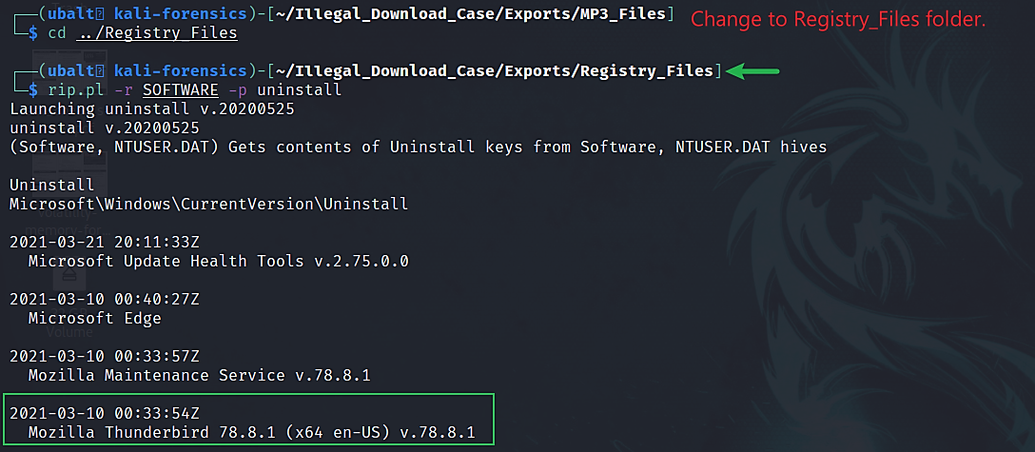
Use Regripper to determine when Mozilla Thunderbird could have been installed.

Slide 7
Explanation
While Mozilla Thunderbird was being installed, it also installed an uninstaller. This is an executable that lets the user uninstall the program.
The Windows Registry recorded the path to this uninstaller on 3/10/2021 at 00:33:54.
This suggests that Thunderbird was installed on the system on 3/10/2021.
Note: This method shows the time the registry recorded information about the uninstaller. The executable itself may have been created at an earlier time than 00:33:54.
Referencing the file directory in the Reference Files folder and the MFT, the creation time was 00:33:45.

Slide 8

What are link files?
Link files are shortcut files that point to an application or file.
Examples: recent documents and shortcuts on the desktop (such as a web browser)
Link files have the extension ‘.lnk’.
Link files can be read using this command:
lnkinfo <link file>
By using lnkinfo, we can obtain:
The file path of the file or application the link file is a shortcut of
Timestamps for its creation
And other important information
Link files can be created by the user or by the operating system.
Further reading: (1) (2)

Slide 9
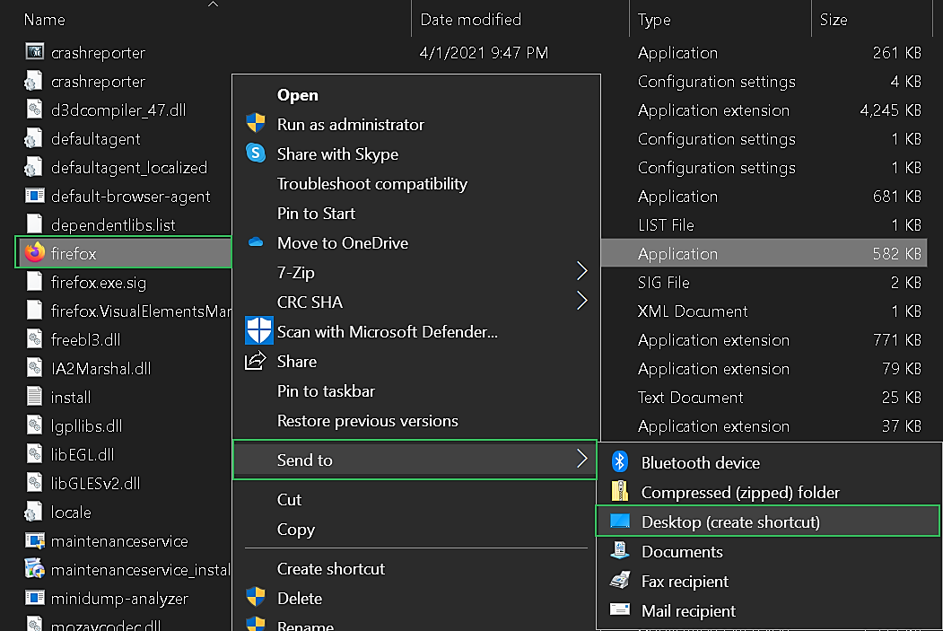
Example of a user creating a lnk file.

Slide 10
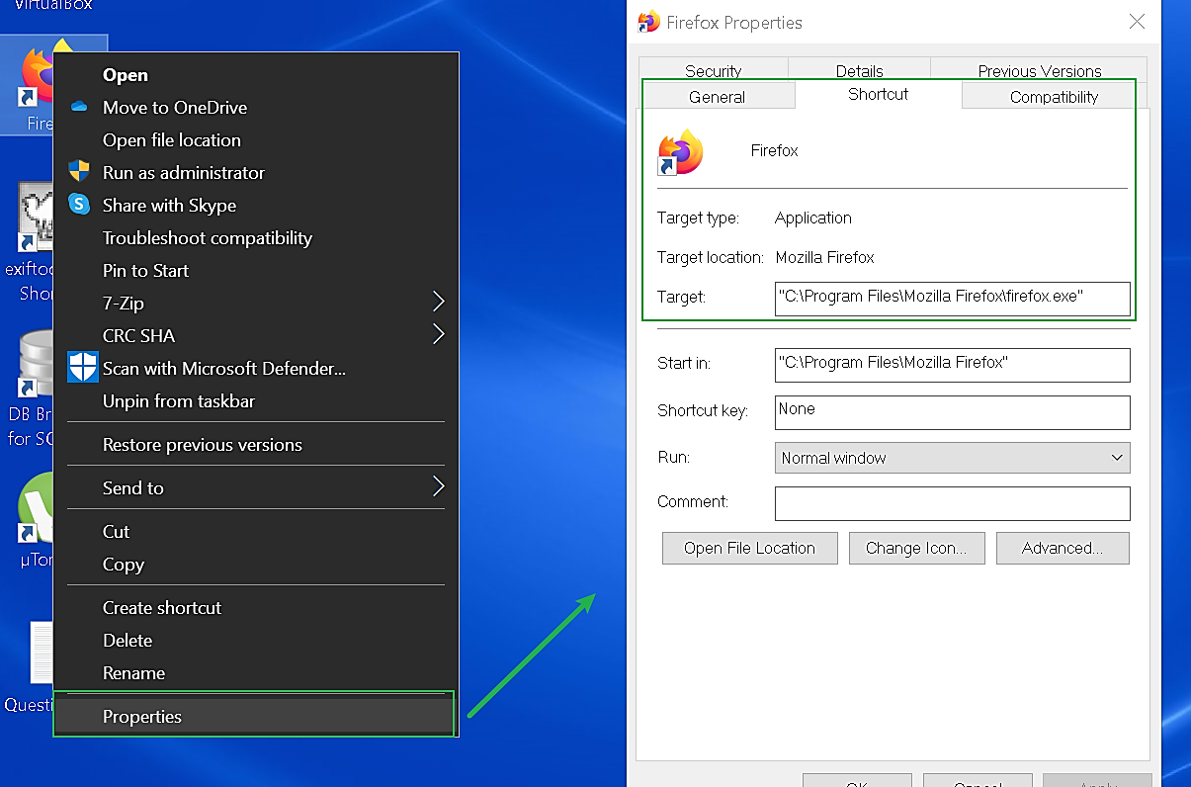
Example of a user creating a lnk file.

Slide 11
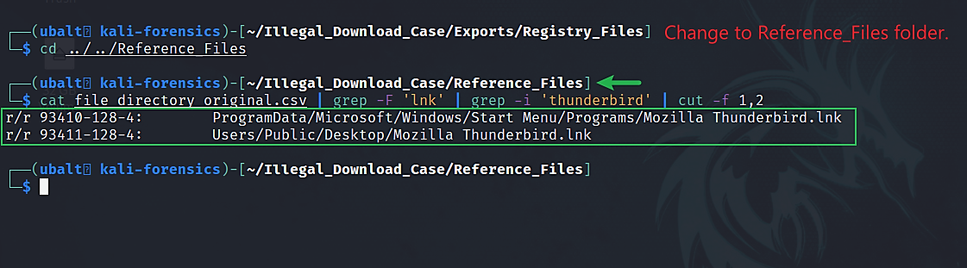
Search the file directory csv file for Thunderbird link files.

Slide 12
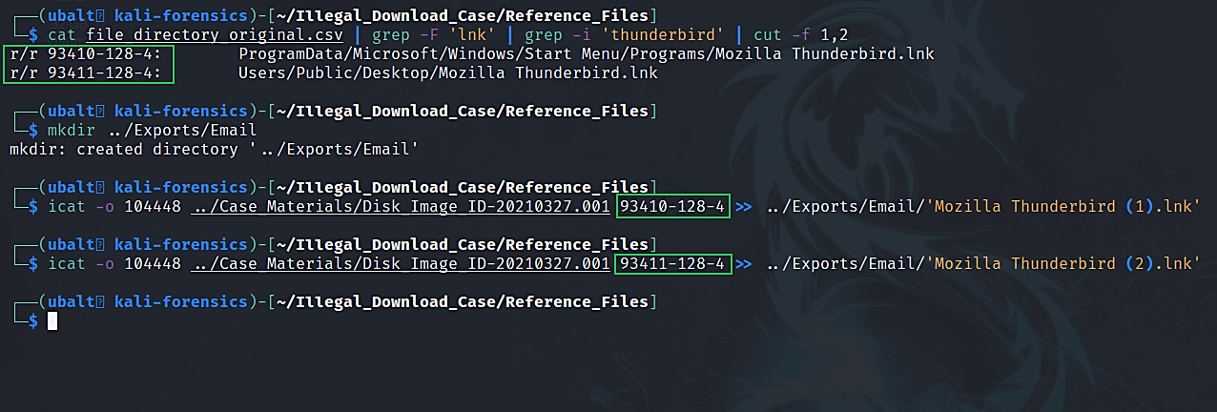
Use icat to extract Thunderbird’s link files.

Slide 13
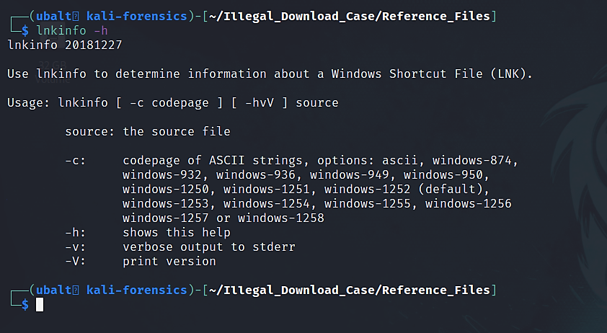
How to get help for lnkinfo.

Slide 14
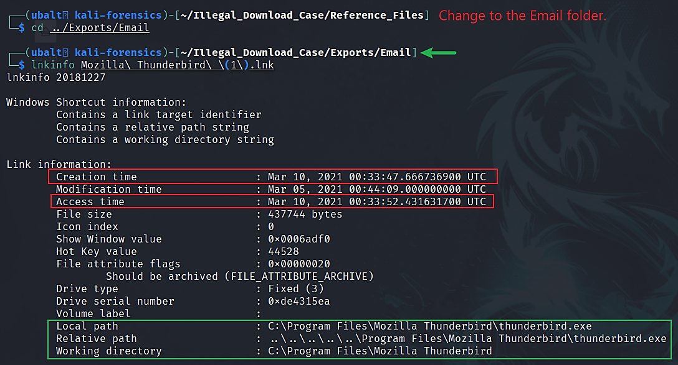
Use lnkinfo to analyze link files.

Slide 15
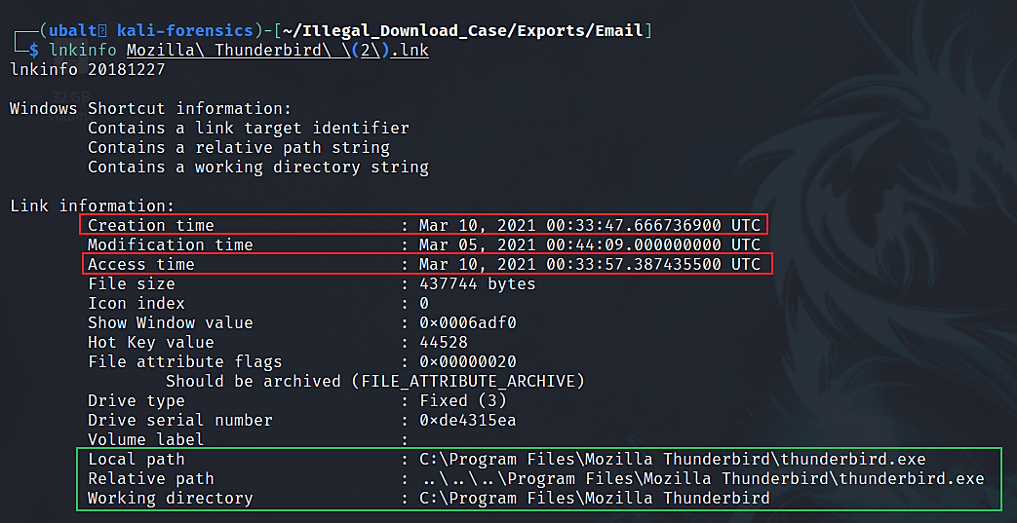
Use lnkinfo to analyze link files.

Slide 16
Explanation
The link files show the same information except for the access time. Both are pointing to /Program Files/Mozilla Thunderbird.
The thunderbird.exe file was created on 03/10/2021 at 00:33:47. This timestamp is also listed for this file’s entry on the MFT.
With this information, we can conclude that Mozilla Thunderbird was installed on this day.

Slide 17
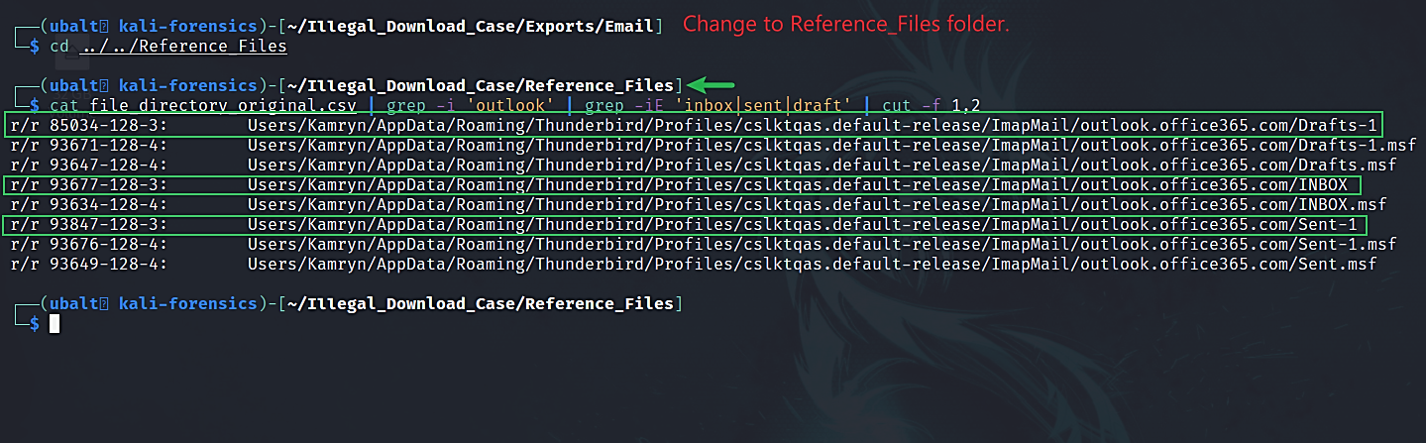
Reference the file directory csv file to find emails.

Slide 18
Explanation
Kamryn’s emails are in Users/Kamryn/AppData/Roaming/Thunderbird/Profiles/cslktqas.default-release/ImapMail/outlook.office365.com.
We are looking at the Inbox and Sent files to see what Kamryn received and sent. Additionally, we will look at the Drafts file just in case Kamryn saved any drafts.
Now that we know where the emails are, we can extract them for further analysis.

Slide 19
14. Analyze Kamryn’s emails. Are there any emails of interest?
Tool(s) used:
Icat
Mutt

Slide 20
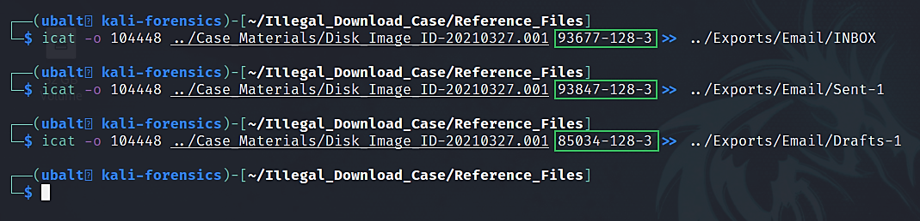
Use icat to extract emails.

Slide 21
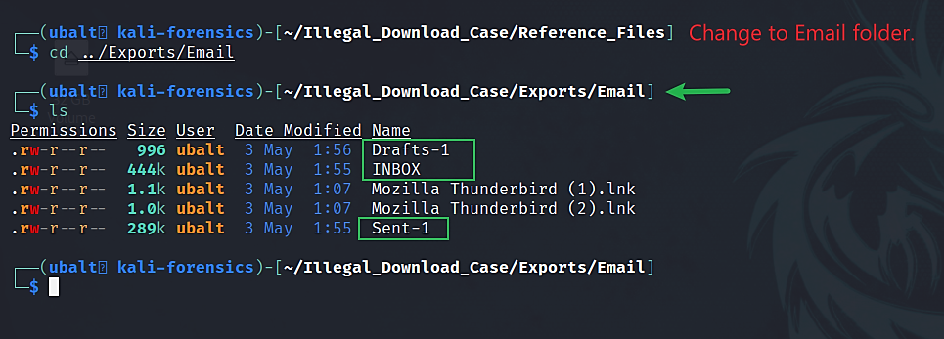
Verify that you have the email files.

Slide 22
How to use Mutt.
Mutt is a terminal-based email application.
While it can be used as a traditional email client like Outlook, it can also be used to read mailbox files.
Mutt supports four mailbox file formats: mbox, mmdf, mh, and maildir.
Thunderbird files are stores in mbox format. Therefore, Mutt can read Kamryn’s emails.
Read more about mbox: https://en.wikipedia.org/wiki/Mbox
Command –
mutt –f <email file> -R

Slide 23
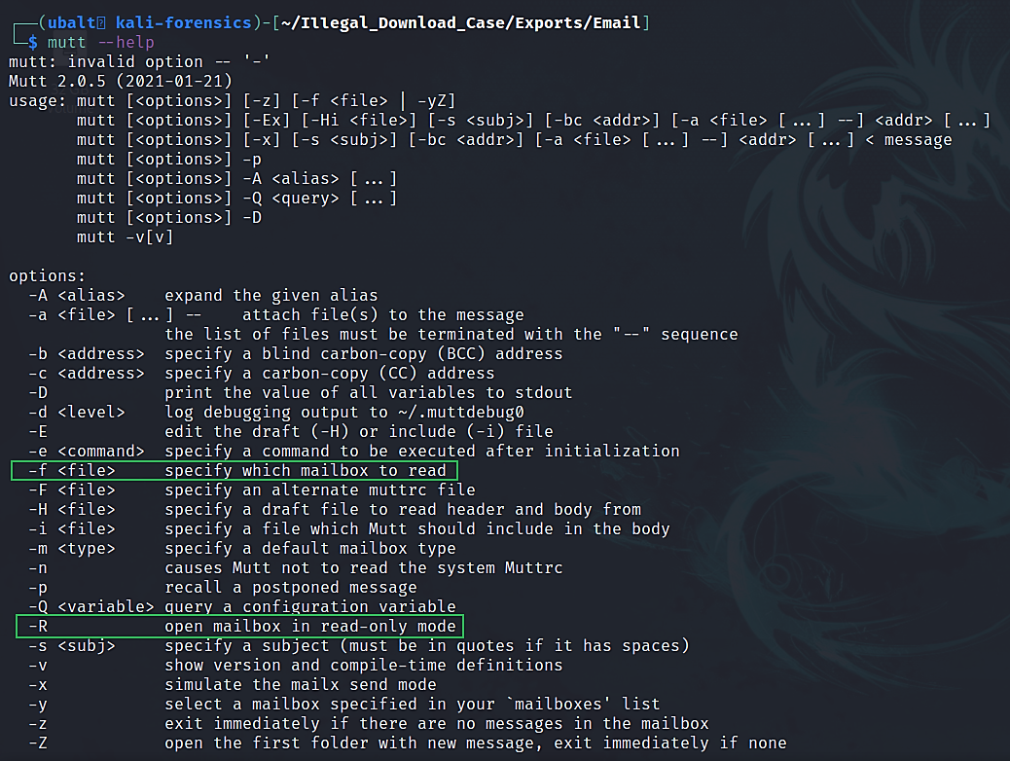
How to get help for Mutt.

Slide 24
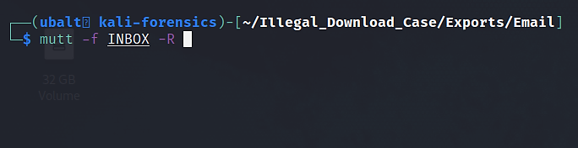
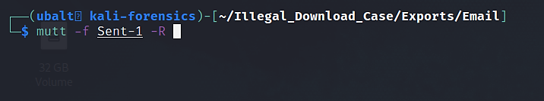
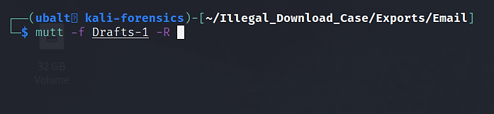
Use Mutt to view Kamryn’s emails.

Slide 25
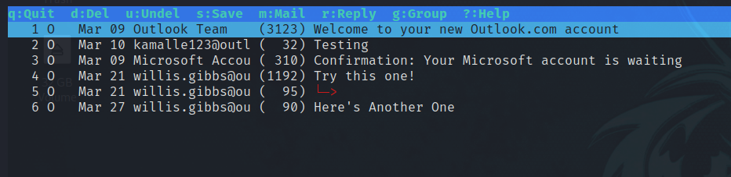
Use Mutt to view Kamryn’s Inbox.
Navigate using the arrow keys.
Press enter when highlighting an email to open it.

Slide 26
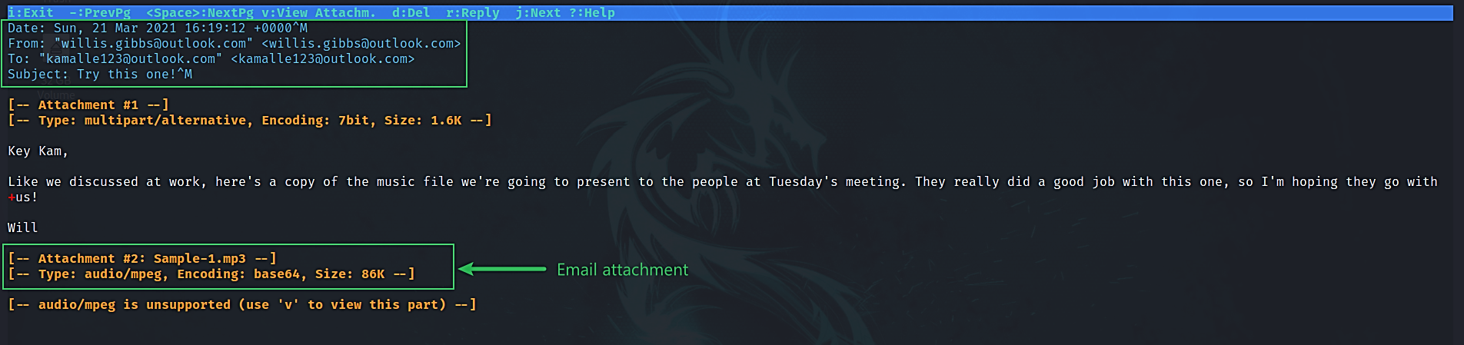
Use Mutt to view Kamryn’s Inbox.
This timestamp is in UTC format.
Timestamps like this that end with ‘+0000’ are already in UTC format, so we do not have to convert.

Slide 27
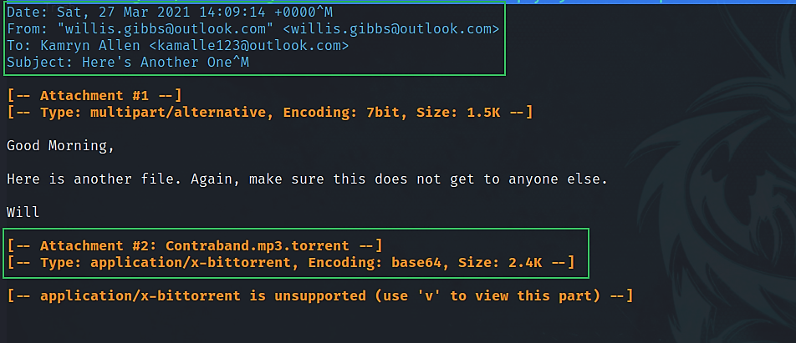
Use Mutt to view Kamryn’s Inbox.
This timestamp is in UTC format.
Timestamps like this that end with ‘+0000’ are already in UTC format, so we do not have to convert.

Slide 28
Important Emails
There are three emails of importance. All three are from Willis Gibbs:
Try this one!
Contains an attachment -> Sample-1.mp3
Re: Try this one! (a reply from Willis)
Here’s Another One!
Contains an attachment -> Contraband.mp3.torrent
According to these emails:
Willis Gibbs sent Kamryn ‘Sample-1.mp3’ and ‘Contraband.mp3.torrent’.
Willis is a possible suspect for creating the Contraband torrent file. We know that Kamryn did not do it as it was created with qBittorrent. Kamryn had uTorrent on the computer.

Slide 29
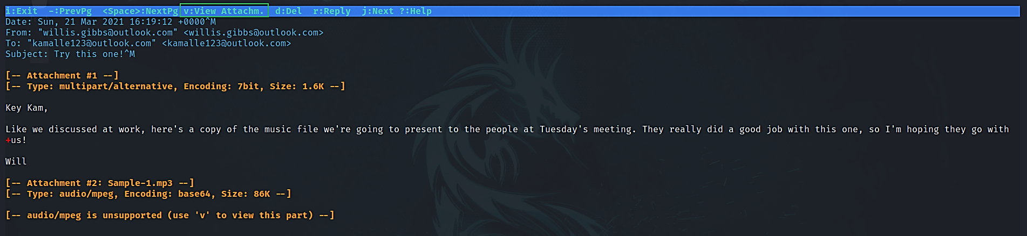
(Optional) Listen to an attachment.
Press ‘v’ to view attachments.

Slide 30
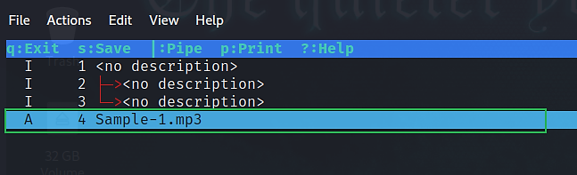
(Optional) Listen to the attachment.
Press enter to listen to the music file. See if it sounds the same as the audio files you have recovered.

Slide 31
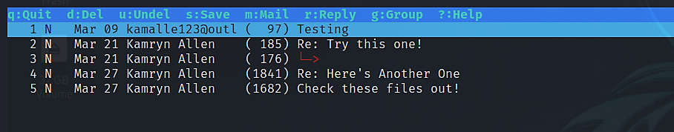
Use Mutt to view Kamryn’s Sent.

Slide 32
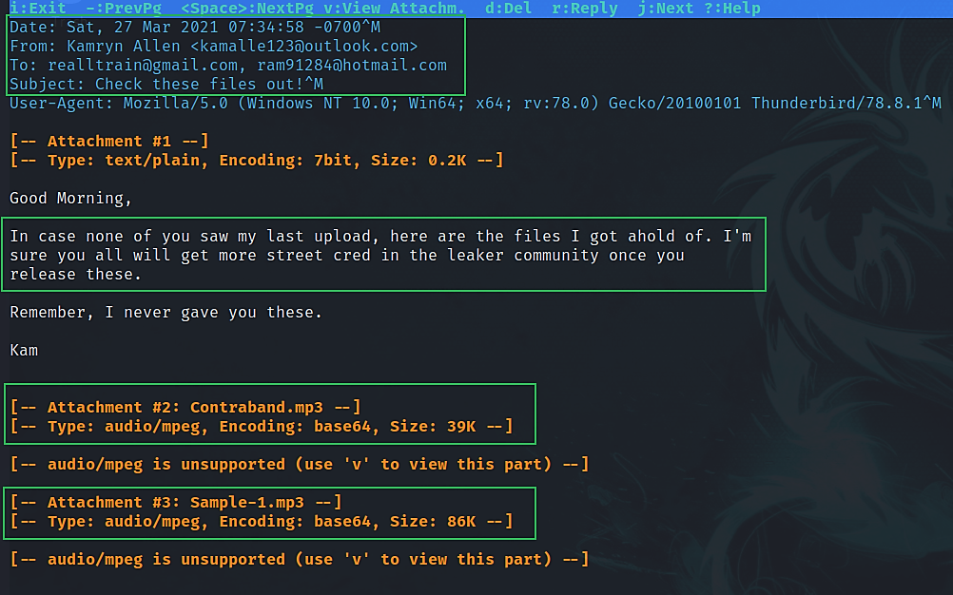
Use Mutt to view Kamryn’s Sent.
This timestamp:
07:34:58 -700 → 7 hours behind UTC time = PDT timezone
14:34:58 is the UTC timestamp.

Slide 33
Important Emails
The important emails are responses to Willis and a message sent to multiple people:
Re: Try this one!
Re: Try this one!
Re: Here’s Another One!
Check these files out!
Contains attachments -> Contraband.mp3, Sample-1.mp3
According to these emails:
Kamryn acknowledges receiving files from Willis Gibbs.
Kamryn sends ‘Contraband.mp3’ and ‘Sample-1.mp3’ to realltrain and ram91284.

Slide 34
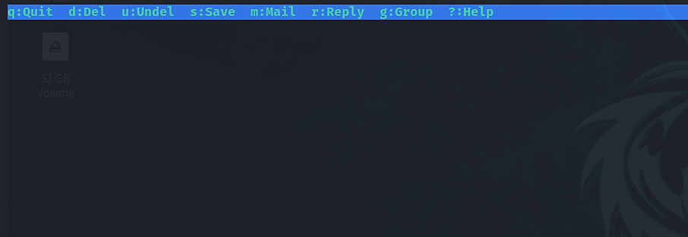
Use Mutt to view Kamryn’s Draft.
There are no drafts!

Slide 35
Overview of email communications.
03/21/2021 –
Try this one! (16:19:12) (from INBOX):
Willis sends Kamryn ‘Sample-1.mp3’.
Re: Try this one! (16:28:51) (from Sent-1):
Kamryn thanks Willis for the file and asks if there are any other files.
Re: Try this one! (16:32:03) (from INBOX):
Willis replies there are no other files and advises Kamryn to not tell anyone else what they are doing.
Re: Try this one! (16:32:56) (from Sent-1):
Kamryn accepts what Willis said and told him to keep her posted.
Notes:
Both timestamps from the ‘Sent-1’ file are incorrect in the file itself. The timestamps on this slide should be taken above the ones in the file.
Currently, we are not sure why the timestamps are not correct in the file.

Slide 36
Overview of email communications.
03/27/2021 –
Here’s Another One! (14:09:14) (from INBOX):
Willis sends Kamryn ‘Contraband.mp3.torrent.’
Re: Here’s Another One! (14:26:59) (from Sent-1):
Kamryn acknowledges receiving the file and says it sounds good.
Check these files out! (14:34:58) (from Sent-1):
Kamryn sends ‘Sample-1.mp3’ and ‘Contraband.mp3’ to ‘realltrain@gmail.com’ and ‘ram91284@hotmail.com’. Kamryn says they will get more ‘street cred in the leaker community’ when they release them.

Slide 37
What does this mean for the investigation?
The two employees Beat Step named are involved in the transmission of the two files they named.
Willis emailed Kamryn Sample-1.mp3 and later Contraband.mp3.torrent.
Willis verifies that the Sample-1.mp3 file was to be presented in a meeting.
Kamryn emailed the .mp3 files to two people. Kamryn insinuates that these two are leakers who could get ‘street cred in the leaker community’.
This suggests that these files can be posted online by these people and/or anyone else they could send the file to.

Slide 38
Next Presentation
Web History

